Slide 1
Regulation of Respiration
Dr. Tabish Masood Ranjha

Slide 2
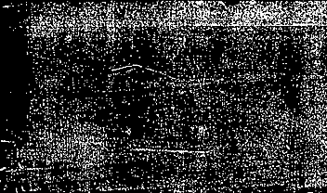
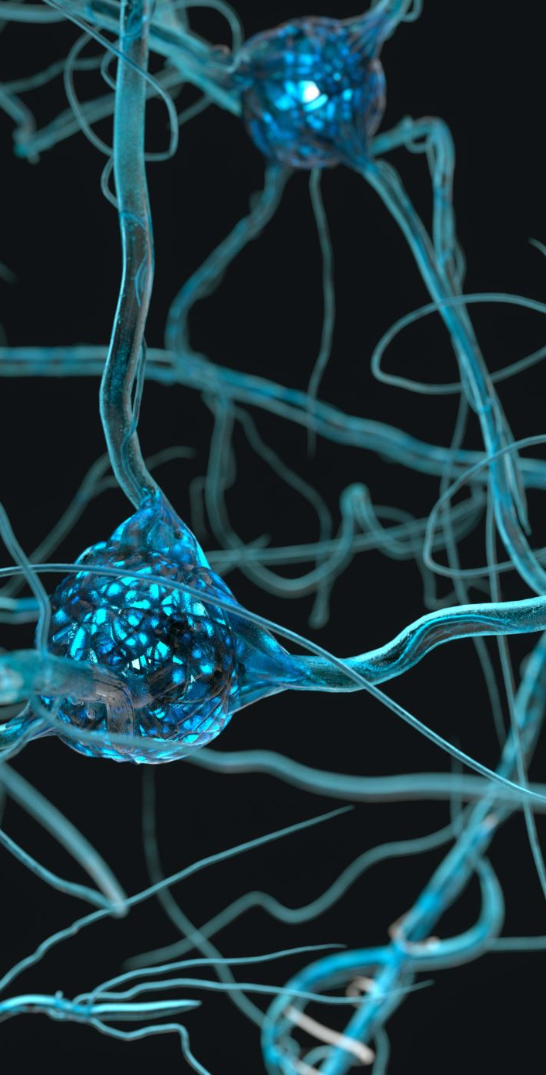

Respiratory center
Normal respiration is spontaneous and unconscious.
There are 4 groups of neurons on each side in the Pons and medulla oblongata which are involved in regulation of respiration. These include
1. Medullary centers
Dorsal respiratory group of neurons
Ventral respiratory group of neurons
2. Pontine centers
Pneumotaxic Centre
Apneustic center.

Slide 3
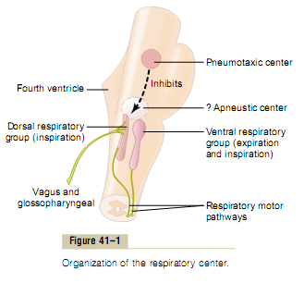

Slide 4
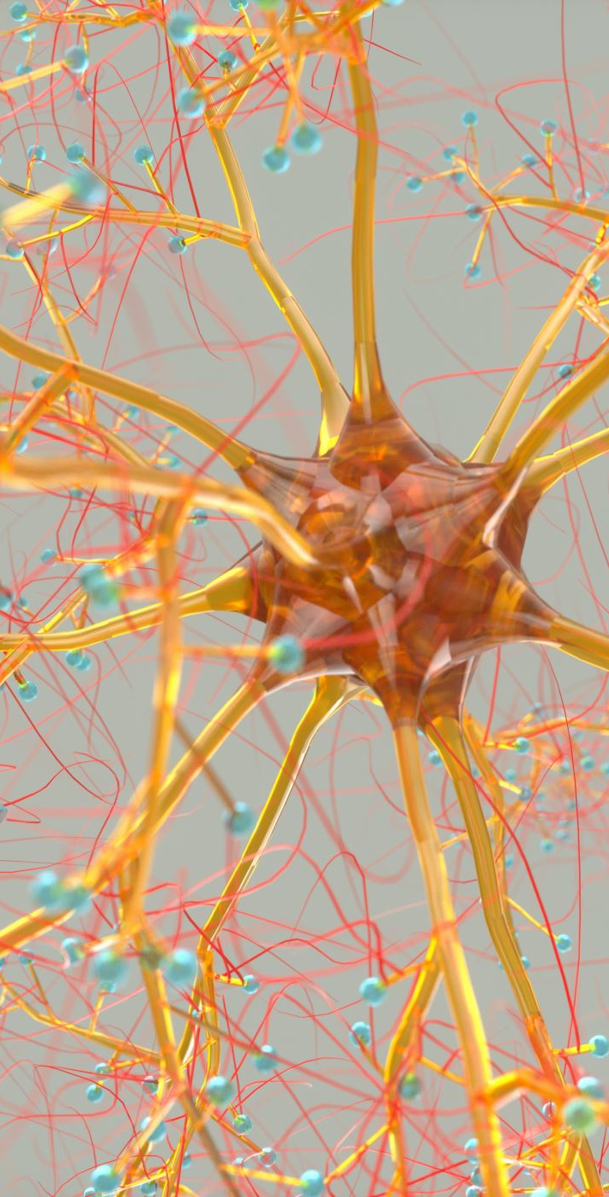
Dorsal Group of Neurons
It contains “I”, neurons which are inspiratory neurons.
It’s located in dorsal portion of medulla oblongata.
It also includes the nucleus of tractus solitarius which is the sensory termination of afferent fibers in 9th ( GLOSSOPHARYNGEAL NERVE) and 10th (VAGUS NERVE) cranial nerves.
They receive impulses from peripheral chemoreceptors, carotid and aortic baroreceptors and also other receptors in the lungs.

Slide 5
Dorsal Group of Neurons
In this group inspiratory ramp signals are produced spontaneously.
If we cut the medulla oblongata from other parts of brain and also the afferent nerves which enter the medulla, still inspiratory ramp signals are produced which indicate it’s the inherent property of medulla.
Initially the signal is weak and then it progressively increases and then fades away.
Each ramp signal’s duration is 2 sec and then for 3 seconds there is no ramp signal.
So each cycle lasts for 5 seconds and there are 12 cycles /minute which is the respiratory rate.

Slide 6
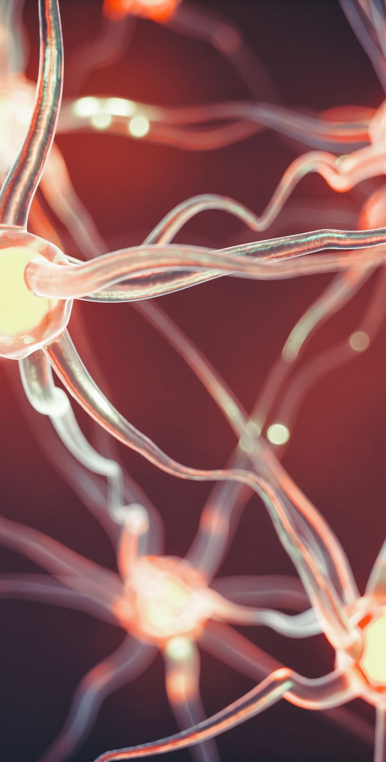
Dorsal Group of Neurons
Significance of the signal in the form of ramp is that it causes progressive expansion of the lungs. After production, these ramp signals are transmitted to the contra lateral motor neurons supplying the inspiratory muscles.
Rate and duration of inspiratory ramp signals is controlled by impulses from the Pneumotaxic Centre and impulses from the lungs via vagi.

Slide 7
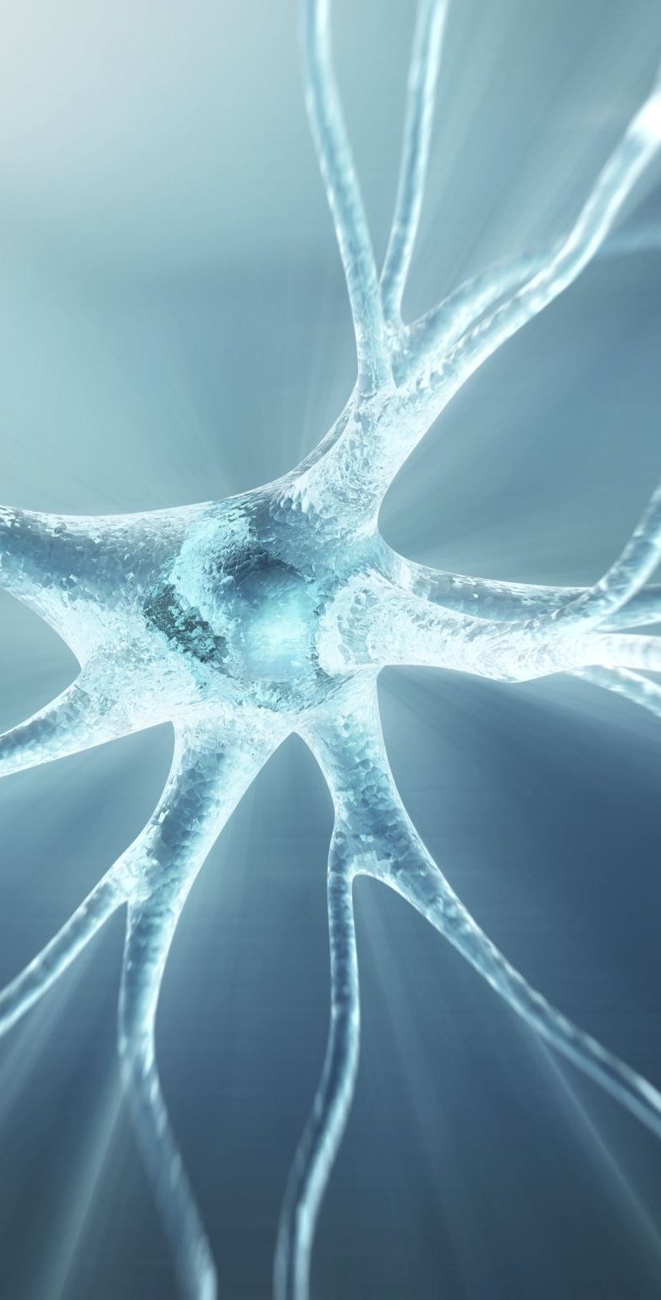
VENTRAL RESPIRATORY GROUP OF NEURONS
Located in the ventral portion of medulla oblongata
Include nucleus ambigus and retro ambiguous
Has both Inspiratory and expiratory neurons.
This group is not involved during quiet breathing
This group is stimulated when there is need for increased pulmonary ventilation.
So this group is stimulated during exercise.

Slide 8
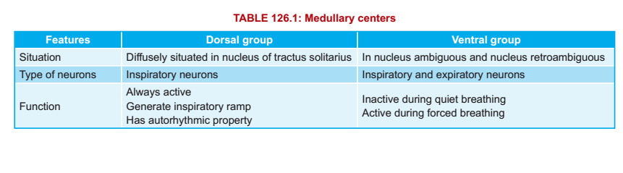

Slide 9
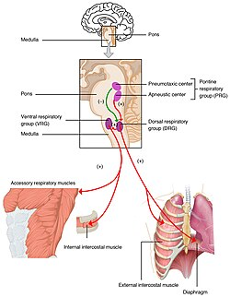
PNEUMOTAXIC CENTRE
Located in the upper Pons
It contains two nuclei i.e. Kolliker fuse and nucleus para brachialis.
Signals from this Centre are transmitted to the dorsal group of neurons to control rate and duration of inspiratory ramp signals.
When signals from this center are strong, inspiratory ramp signals are terminated early and there is increase in respiratory rate
When signals from this center are weak, inspiratory ramp signals are not terminated early leading to decreased Respiratory rate.

Slide 10
APNEUSTIC CENTRE
Not well understood.
Located in lower Pons.
Physiological role is not certain, however when this center is stimulated there is Apneusis i.e. prolonged inspiration with short expiration.
It may provide extra stimulation to dorsal group of neurons.

Slide 11
Regulation of Respiration
Activity of the respiratory center is controlled by :-
Nervous Stimuli (Nervous regulation)
Chemical Stimuli (Chemical Regulation)

Slide 12
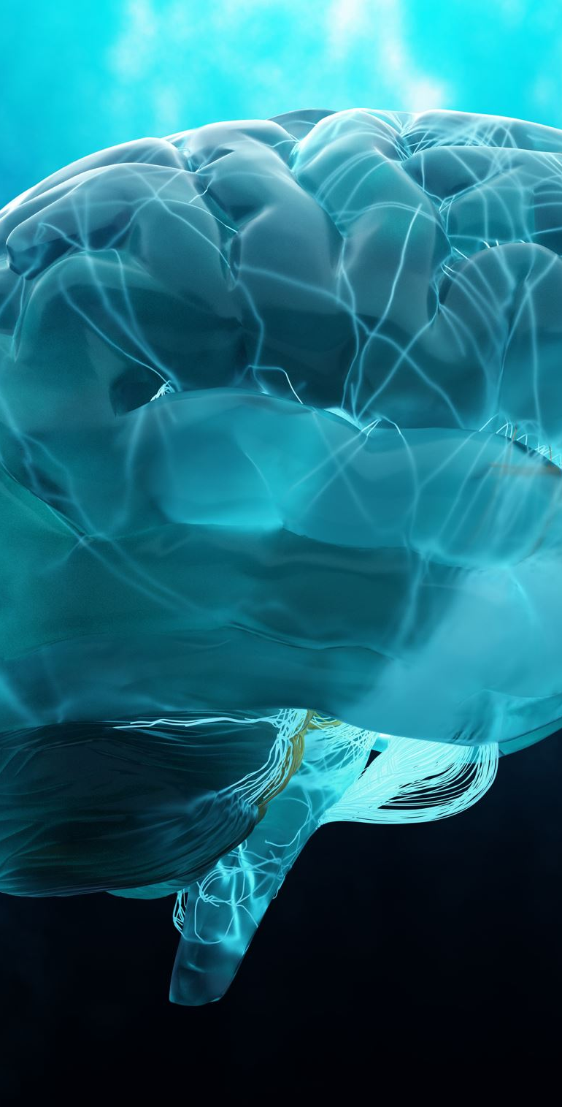
Nervous Regulation
Impulses from Higher centers: During emotional states, respiration is modified by impulses from higher centers i.e. cerebral cortex, limbic system, and hypothalamus.
For voluntary hypo and hyperventilation: Impulses arise from the cerebral cortex and go directly to the motor neurons supplying the inspiratory muscles.
Impulses from Proprioceptors: Proprioceptors are the receptors presents around joints, in muscles, ligaments, tendons and deeper parts of skin. These receptors respond to changes in position and movement. Impulses from these proprioceptors go to the respiratory center to stimulate it. These are the major stimulatory factors to stimulate respiration during exercise.

Slide 13
Nervous Regulation
Impulses from Irritant receptors: These are nerve endings present in the epithelium of airways; these are stimulated by mechanical irritants like mucus, sputum or foreign body or may be stimulated by chemical stimuli like histamine and bradykinin. These receptors are involved in cough and sneezing reflex.
Impulses from stretch receptors in the lungs: when lungs are inflated, impulses from stretch receptors in the lungs are stimulated and transmitted along the vagi to the respiratory center to terminate inspiratory ramp signal. These receptors are stimulated when lungs are over inflated and in human beings, herring Breuer reflex is activated, when the tidal volume is 1 – 1.5 liters. This reflex prevents over inflation of lungs.

Slide 14
Nervous Regulation
Impulses from J receptors: J means juxta position to pulmonary capillaries.
Stimulated when some irritant chemical is present in the pulmonary blood or when there is engorgement of pulmonary capillaries or there is pulmonary edema.
This leads to rapid breathing.
Visceral reflexes: There is physiological apnea during swallowing.
There is short apnea during defecation, vomiting.
During inspiration heart rate increases and during expiration it decreases.
Application of cold water over the body leads to hyperventilation.
When cold water is applied only to the face, there is hypoventilation.

Slide 15
Nervous Regulation
Effect of sleep on respiration: during sleep respiration is less controlled because of less sensitivity of respiratory centers to CO2.
During REM SLEEP irregular respiration
In slow wave sleep respiration is regular
In certain individuals there is sleep apnea syndrome in which respiration stops suddenly and frequently during night
Effect of temperature on Respiratory center: Increased temperature stimulates respiratory center by two mechanisms
direct stimulatory effect
indirect by increased metabolic rate, Increased PCO2, decreased PO2, H ions concentration increases which leads to hyperventilation.

Slide 16
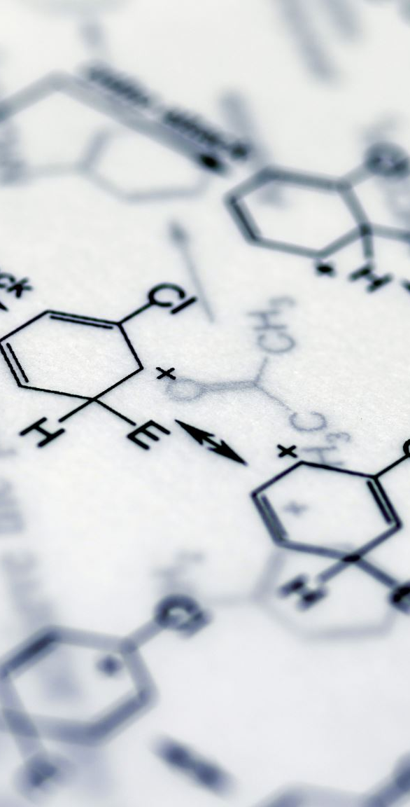
Chemical Regulation
Chemical changes in the body modify the activity of respiratory center.
These changes include
Changes in PCO2
Changes in H ion concentration
Changes in PO2
One of the aim of the respiration is to keep the above-mentioned stimuli within normal limits.
These chemical stimuli don’t affect the respiratory centers directly.
These chemical stimuli first act on chemoreceptors which in turn affect the activity of respiratory centers.

Slide 17

CHEMORECEPTORS
Central chemoreceptors: present in the chemo sensitive area in the anterolateral portion of the medulla oblongata.
Peripheral chemoreceptors: present in the carotid and aortic bodies.
Carotid bodies are present in the angle between the external and internal carotid arteries. From these impulses are first carried by herring’s nerves which join the glossopharyngeal nerve.
Aortic bodies are present along the arch of aorta and from here impulses are carried by the afferent nerve fibers in the vagi.
Impulses from both these go to dorsal group of neurons

Slide 18
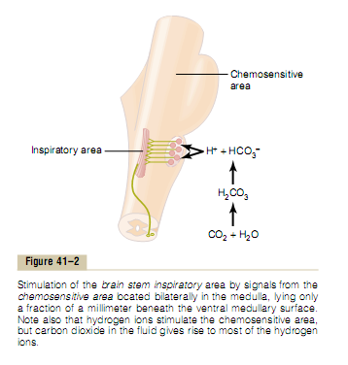

Slide 19
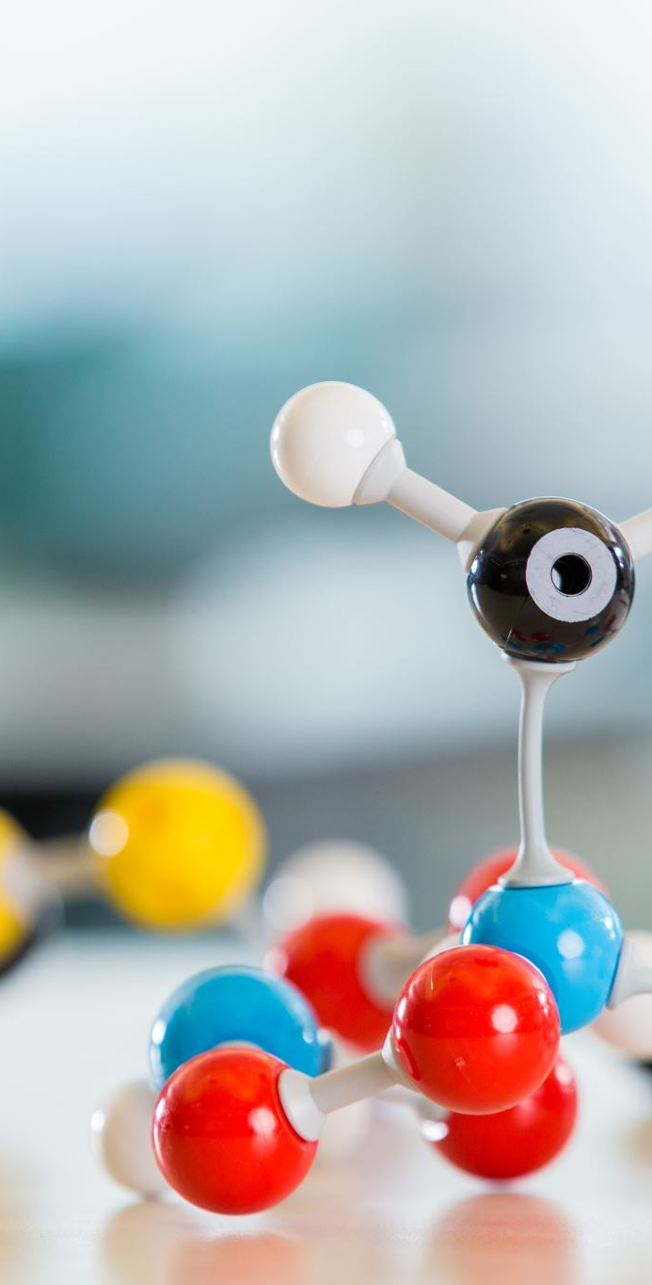
Changes in PCO2
CO2 can cross both the blood brain barrier and blood CSF barrier
It binds with water to form Carbonic acid in the presence of carbonic anhydrase enzyme.
Carbonic acid is unstable and dissociates immediately into Hydrogen ions and bicarbonate ions.
H ions produced directly stimulate the chemo sensitive area.
H ions are the most powerful stimulus of chemo sensitive area.
Increased PCO2 can also stimulate respiratory center through peripheral chemoreceptors.
So, the effect is through both central and peripheral chemoreceptors however effect through central chemoreceptors is much more pronounced.
H ions produced in CSF is much more potent stimulator than the H ions produced in brain.

Slide 20
Changes in H Ion Concentration
Whenever H ions concentration Increase in arterial blood it stimulate the peripheral chemoreceptor.
They can’t cross the blood brain barrier.
In animal, if we denervate the carotid and aortic bodies and change the pH there won’t be any effect on respiration .

Slide 21
Changes in PO2
Hypoxia stimulates the respiration through peripheral chemoreceptors.
When arterial PO2 falls from its normal value of 95 to 60 mm of Hg, there is no stimulatory effect of hypoxia.
During this, increased amount of deoxyhemoglobin is formed which can bind more CO2 and H ions.
So stimulatory affect of hypoxia is neutralized by increased binding of H ions and CO2 with deoxyhemoglobin.
Its stimulatory effect starts when PO2 falls below 60 mm of Hg.
At this stimulatory effect becomes so strong that it overcomes the binding of CO2 and H ions with deoxyhemoglobin.
This effect becomes marked when PO2 falls below 40 mm of Hg.

Slide 22
If we compare the relative stimulatory effect of above stimuli then we can say that the effect of Increase PCO2 is 1000%, increased H ions is 400 % and least affect is through decreased PO2 i.e. 66 %.

Slide 23
Hering-Breuer Reﬂex
Hering Breuer reﬂex is a protective reﬂex that restricts inspiration and prevents overstretching of lung tissues.
It is initiated by the stimulation of stretch receptors of air passage.
Stretch receptors are the receptors which give response to stretch of the tissues. These receptors are situated on the wall of the bronchi and bronchioles.

Slide 24
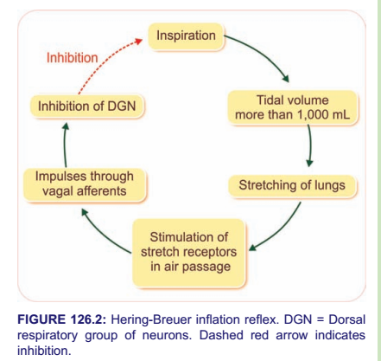

Slide 25
REGULATION OF RESPIRATION DURING EXERCISE

Slide 26
There is tremendous increases in demand for oxygen during exercise i.e. more than 100 times increase in oxygen consumption.
So, there is need for increased pulmonary ventilation.
During exercise, the chemical stimuli for respiration i.e. PCO2, PO2 and H ion concentration remain within normal limits except during very strenuous exercise

Slide 27
When a person intends to exercise, impulses from motor cortex go to the muscles to initiate the muscle contraction, simultaneously impulses are sent to respiratory center to increase the rate of pulmonary ventilation.
When there is start of exercise, impulses from the proprioceptors from the joints go to the respiratory center to stimulate ventilation. This is the major stimulatory factor.
Increased temperature during exercise stimulates the respiratory center to increase ventilation

Slide 28
